Slide 1
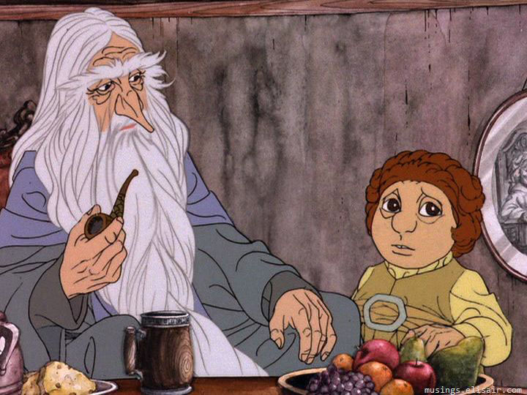
How the TV “Hobbit” Came to Be
Russell A. Potter, Ph.D.

Slide 6
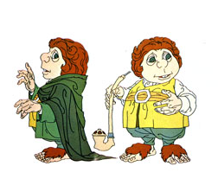

Slide 10
